Slide 1
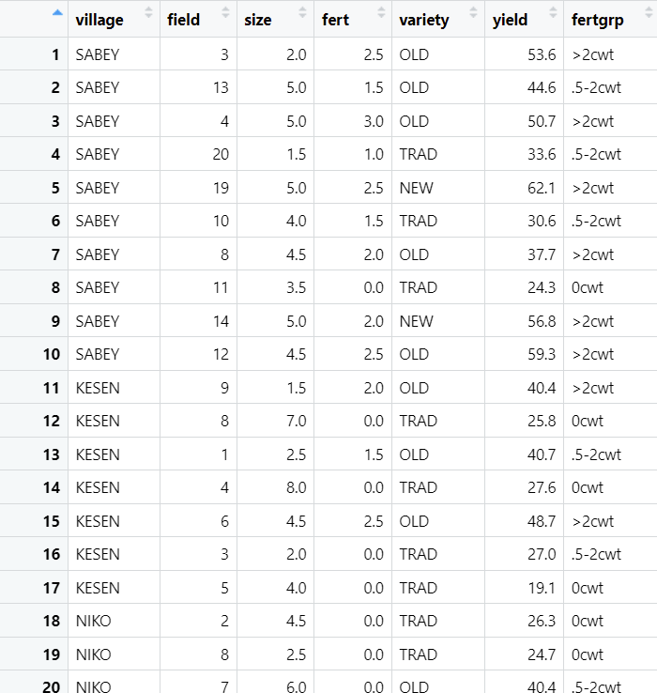
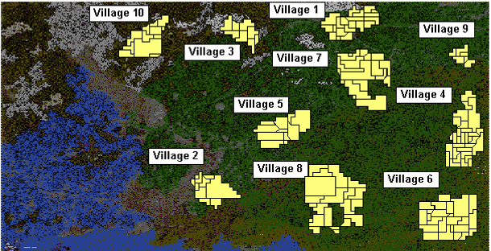

Slide 2
 | 0 | 1 | 1.5 | 2 | 2.5 | 3
Traditional | 9 | 1 | 2 | 2 | 0 | 1
Old | 1 | 2 | 4 | 4 | 4 | 2
New | 0 | 0 | 0 | 2 | 2 | 0

Slide 3
 | 0 | 1 | 1.5 | 2 | 2.5 | 3
Traditional | 2 | 2 | 2 | 2 | 2 | 2
Old | 2 | 2 | 2 | 2 | 2 | 2
New | 2 | 2 | 2 | 2 | 2 | 2

Slide 4
